Slide 1
CHAPTER 14:
Confidence Intervals:
The Basics
The Basic Practice of Statistics
6th Edition
Moore / Notz / Fligner
Lecture PowerPoint Slides
Notes:
Basic Practice of Statistics - 3rd Edition
Chapter 5

Slide 2
Chapter 14 Concepts
The Reasoning of Statistical Estimation
Margin of Error and Confidence Level
Confidence Intervals for a Population Mean
How Confidence Intervals Behave

Slide 3
Chapter 14 Objectives
Define statistical inference
Describe the reasoning of statistical estimation
Describe the parts of a confidence interval
Interpret a confidence level
Construct and interpret a confidence interval for the mean of a Normal population
Describe how confidence intervals behave

Slide 4



Statistical Inference
After we have selected a sample, we know the responses of the individuals in the sample. However, the reason for taking the sample is to infer from that data some conclusion about the wider population represented by the sample.
Statistical Inference
Statistical inference provides methods for drawing conclusions about a population from sample data.
Population
Sample
Collect data from a representative Sample...
Make an Inference about the Population.

Slide 5
Simple Conditions for Inference
About a Mean
This chapter presents the basic reasoning of statistical inference. We start with a setting that is too simple to be realistic.
Simple Conditions for Inference About a Mean
We have an SRS from the population of interest. There is no nonresponse or other practical difficulty.
The variable we measure has an exactly Normal distribution N(μ,σ) in the population.
We don’t know the population mean μ, but we do know the population standard deviation σ.
Note: The conditions that we have a perfect SRS, that the population is exactly Normal, and that we know the population standard deviation are all unrealistic.

Slide 6
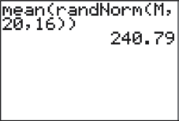
The Reasoning of Statistical Estimation
Your teacher has selected a “Mystery Mean” value µ and stored it as “M” in their calculator. The following command was executed on their calculator: mean(randNorm(M,20,16))
The result was 240.79. This tells us the calculator chose an SRS of 16 observations from a Normal population with mean M and standard deviation 20. The resulting sample mean of those 16 values was 240.79.
Suppose we want to determine an interval of reasonable values for the population mean µ. We can use the result above and what we learned about sampling distributions in the previous chapters.

Slide 7
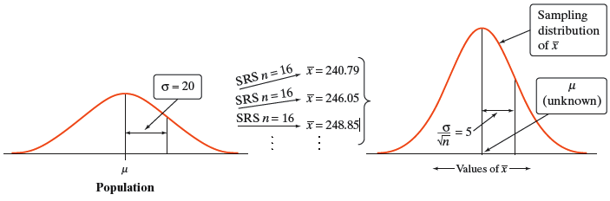
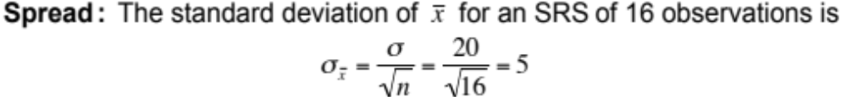
The Reasoning of Statistical Estimation
Since the sample mean is 240.79, we could guess that µ is “somewhere” around 240.79. How close to 240.79 is µ likely to be?
To answer this question, we must ask another:

Slide 8
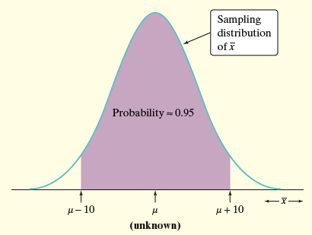
The Reasoning of Statistical Estimation
In repeated samples, the values of the sample mean will follow a Normal distribution with mean µ and standard deviation 5.
The 68-95-99.7 Rule tells us that in 95% of all samples of size 16, the sample mean will be within 10 (two standard deviations) of µ.
If the sample mean is within 10 points of µ, then µ is within 10 points of the sample mean.
Therefore, the interval from 10 points below to 10 points above the sample mean will “capture” µ in about 95% of all samples of size 16.
If we estimate that µ lies somewhere in the interval 230.79 to 250.79, we’d be calculating an interval using a method that captures the true µ in about 95% of all possible samples of this size.

Slide 9

Confidence Interval
The Big Idea: The sampling distribution of tells us how close to µ the sample mean is likely to be. All confidence intervals we construct will have a form similar to this:
estimate ± margin of error
Confidence Interval
A level C confidence interval for a parameter has two parts:
An interval calculated from the data, which has the form:
estimate ± margin of error
A confidence level C, which gives the probability that the interval will capture the true parameter value in repeated samples. That is, the confidence level is the success rate for the method.
We usually choose a confidence level of 90% or higher because we want to be quite sure of our conclusions. The most common confidence level is 95%.

Slide 10
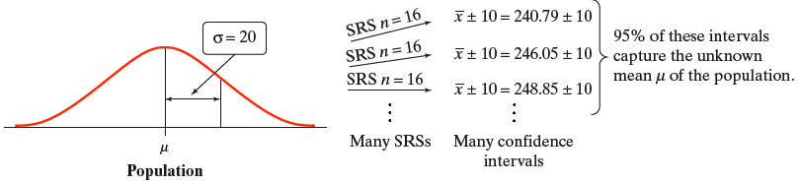
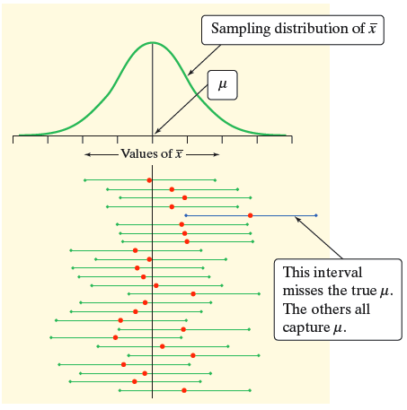
Confidence Level
The confidence level is the overall capture rate if the method is used many times. The sample mean will vary from sample to sample, but when we use the method estimate ± margin of error to get an interval based on each sample, C% of these intervals capture the unknown population mean µ.
Interpreting a Confidence Level
To say that we are 95% confident is shorthand for “95% of all possible samples of a given size from this population will result in an interval that captures the unknown parameter.”

Slide 11
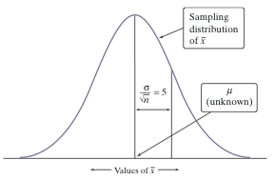
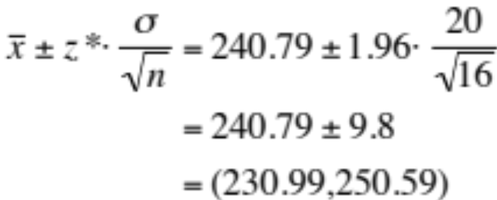
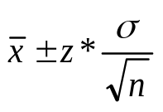
Confidence Intervals for a Population Mean
Previously, we estimated the “mystery mean” µ by constructing a confidence interval using the sample mean = 240.79.
To calculate a 95% confidence interval for µ , we use the familiar formula:
estimate ± (critical value) • (standard deviation of statistic)
Confidence Interval for the Mean of a Normal Population
Choose an SRS of size n from a population having unknown mean µ and known standard deviation σ. A level C confidence interval for µ is:
The critical value z* is found from the standard Normal distribution.

Slide 12
Confidence Intervals: The Four-Step Process
Confidence Intervals: The Four-Step Process
State: What is the practical question that requires estimating a parameter?
Plan: Identify the parameter, choose a level of confidence, and select the type of confidence interval that fits your situation.
Solve: Carry out the work in two phases:
1. Check the conditions for the interval that you plan to use.
2. Calculate the confidence interval.
Conclude: Return to the practical question to describe your results in this setting.

Slide 13
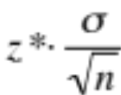
How Confidence Intervals Behave
The z confidence interval for the mean of a Normal population illustrates several important properties that are shared by all confidence intervals in common use.
The user chooses the confidence level and the margin of error follows.
We would like high confidence and a small margin of error.
  High confidence suggests our method almost always gives correct answers.
  A small margin of error suggests we have pinned down the parameter precisely.
How do we get a small margin of error?
The margin of error for the z confidence interval is:
The margin of error gets smaller when:
z* gets smaller (the same as a lower confidence level C)
σ is smaller. It is easier to pin down µ when σ is smaller.
n gets larger. Since n is under the square root sign, we must take four times as many observations to cut the margin of error in half.

Slide 14
Chapter 14 Objectives Review
Define statistical inference
Describe the reasoning of statistical estimation
Describe the parts of a confidence interval
Interpret a confidence level
Construct and interpret a confidence interval for the mean of a Normal population
Describe how confidence intervals behave

